Slide 1
STUN and TURN Servers
Presented by
Md. Khalid Hossen

Slide 2
What is STUN server ?
STUN is stand for (Session Traversal Utilities for NAT) that allows clients to discover their public IP address and the type of NAT they are behind. This information is used to establish the media connection. In most cases, a STUN is only used during the connection setup and once that session server has been established, media will flow directly between the peer and the Video Gateway (WebRTC).

Slide 3
What is a TURN Server?
A TURN (Traversal Using Relays around NAT) server goes around the network address, essentially traversing the connection using relays. So when a STUN server cannot establish a connection between the two parties, the TURN server steps in as an intermediary.

Slide 4
TURN Vs STUN
TURN | STUN
TURN is a relay | STUN is not a relay
both clients send data to the TURN server, which forwards it to the other client. | the STUN server helps to "make the connection" between the clients (by discovering and exchanging their external host:port pairs), after which they send data to each other directl
STUN work with all NAT/firewall setups, so TURN is used when STUN fails. | STUN doesn't work with all NAT/firewall setups, so TURN is used when STUN fails.

Slide 5
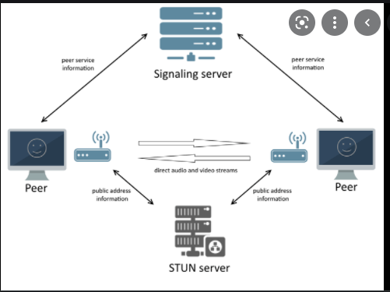
STUN server flow :

Slide 6
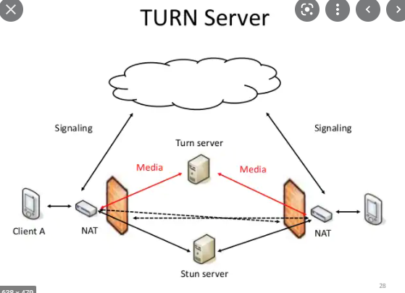
Turn server work flow:

